Slide 1
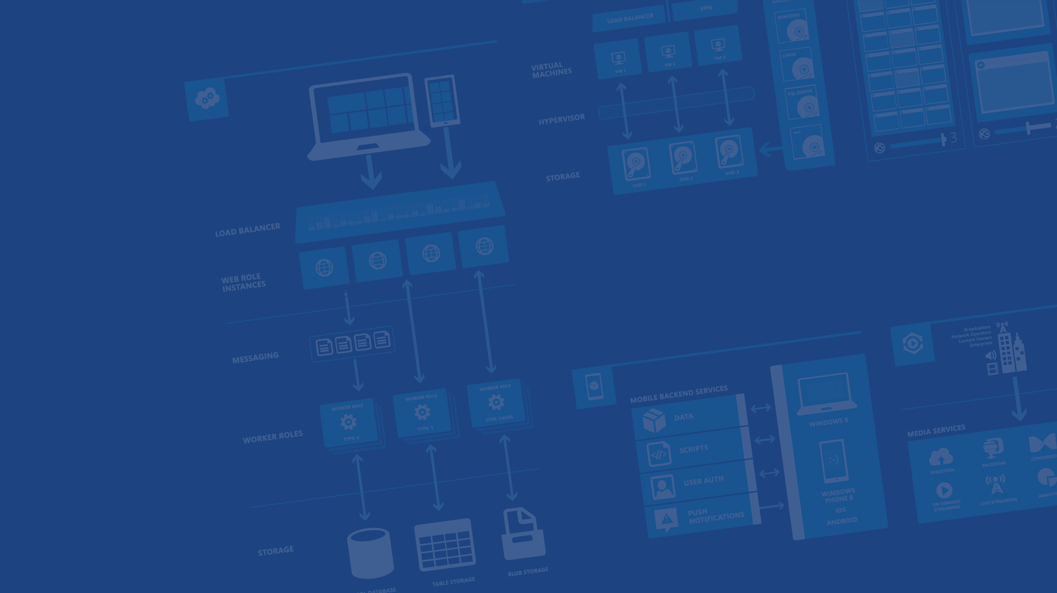
Cloud Powered Mobile Apps with Azure
Balint Farkas
Technical Evangelist
Microsoft
Microsoft Azure

Slide 2


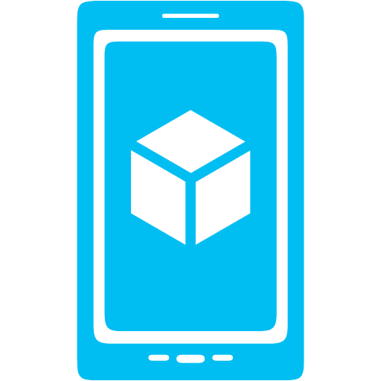



What is Mobile Services?
Storage
Authentication
Push
Logic

Slide 3
Backends
JavaScript: Node.js
C#: ASP.NET Web Api
Microsoft Azure

Slide 4
Demo: Create Mobile Service

Slide 5
Structured Storage
Powered by SQL Database
Supports rich querying capabilities
Dynamic Schematization
Supports offline sync
Libraries for: Azure Storage, Redis, MongoDB etc – full Node.js/ASP.NET power
Microsoft Azure

Slide 6
Demo: Data Access
Online, offline

Slide 7
Authentication
Facebook, Google, Microsoft
Azure Active Directory
Microsoft Azure

Slide 8
Data Authorization
Per HTTP method auth options:
Everyone
App Key Required
Not ideal for production use
Authenticated Users
Admins and other scripts
Requires Master Key as header
401 Unauthorized response if security check fails
Microsoft Azure

Slide 9
Demo: Adding Auth
Lock Down and Login

Slide 10
Push Notification Flow
Client
Mobile Services
Register for push notifications with PNS
Send your identifier to Mobile Service
Send push from server scripts
PNS delivers notification to device
App
(2)
(3)
(4)
(1)
PNS
Microsoft Azure

Slide 11
Notification Hubs
Separate from Mobile Services
Can be used regardless of whether you’re storing data in Azure
Extremely scalable push notifications
Cross platform support
Push to iOS, Android, Kindle, Windows Phone, Windows Store
Tags (i.e. tie my registration to this topic or user ID)
Templates (i.e. when I get a push, send it in this format)
Server SDKs for .NET, Java, and Node (also open as REST API)
Microsoft Azure

Slide 12
Demo: Adding Push

Slide 13
What’s next?
Scripting (tables, custom APIs, scheduling); source control
More on Storage
Scaling, pricing
Microsoft Azure

Slide 14

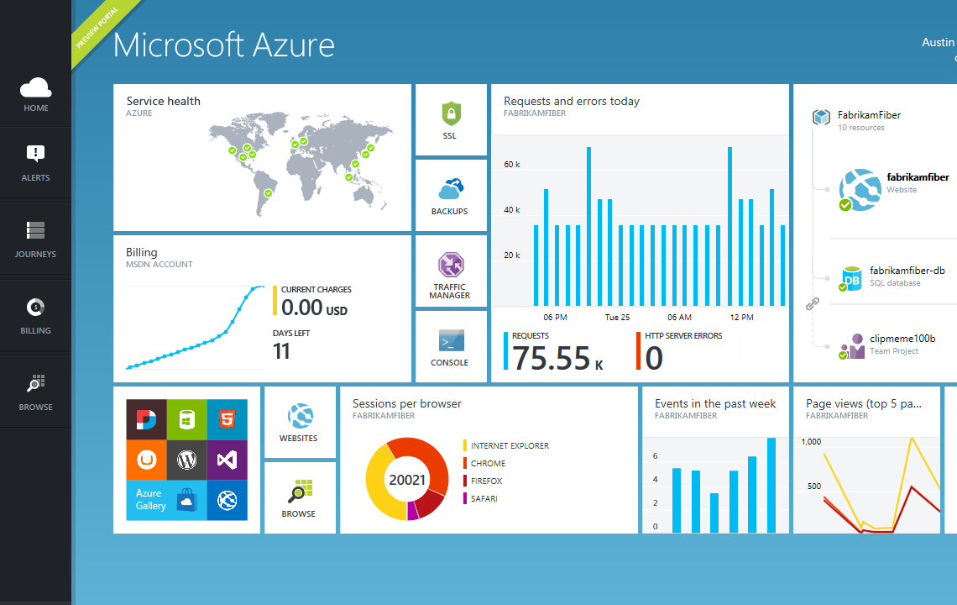

Get started
Visit azure.microsoft.com

